Slide 1

Welcome!
Notes:
1

Slide 2
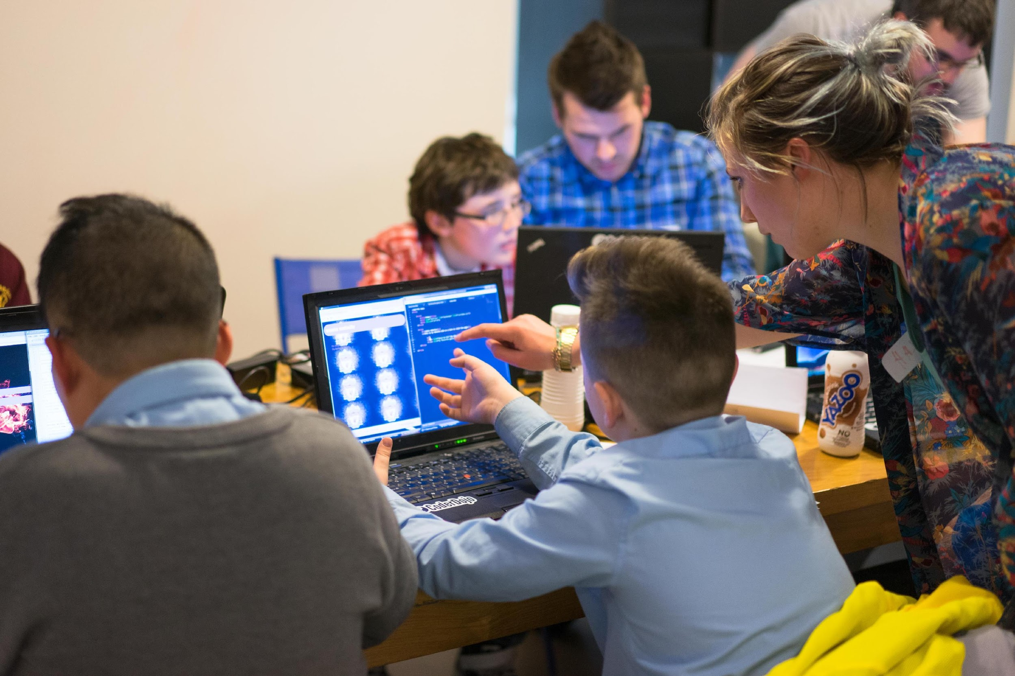
Steps to start a CoderDojo
1. Find a Champion
2. Register on Zen
3. Gather a team
4. Find a Venue
5. Plan your first session
6. Promote the Dojo!
Notes:
2

Slide 3
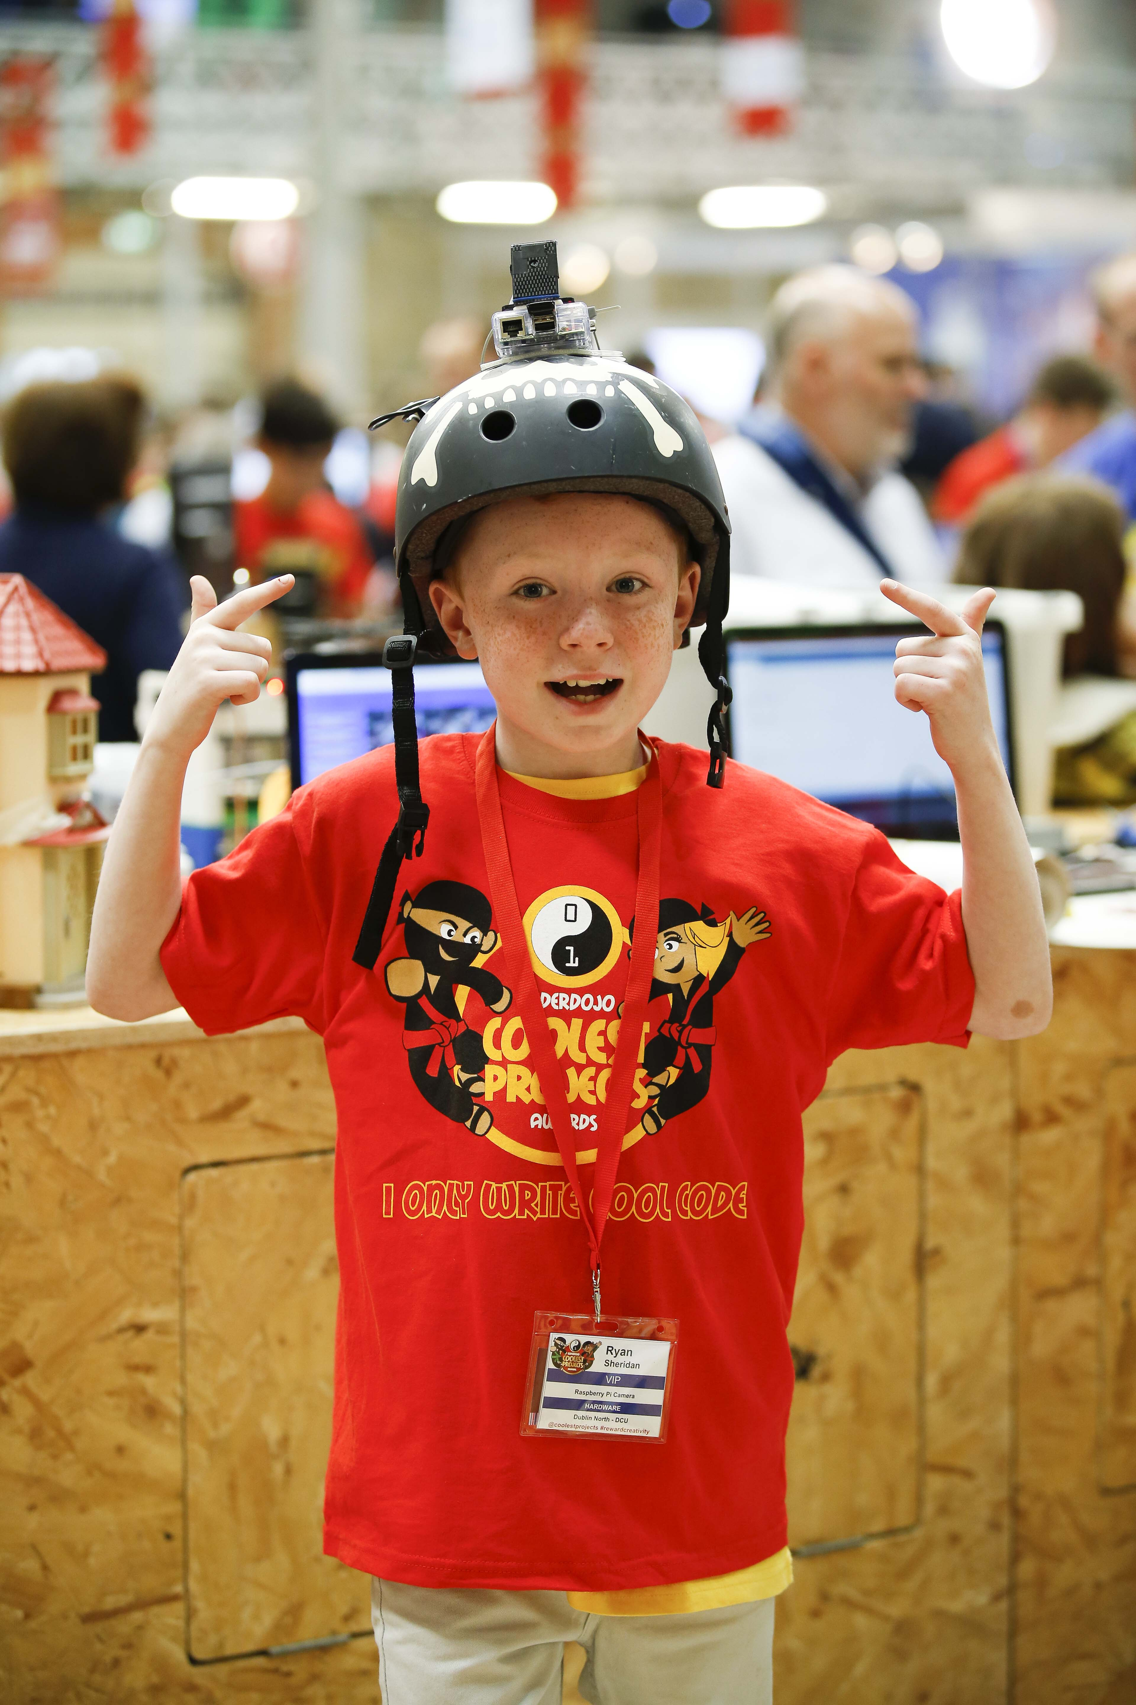
Groups you can approach in your region
Public Libraries
Youth Organisations
Tech Companies / Startup Hubs
Educational institutes
Notes:
I’m going to go through the groups and what they can provide to make it easy for Dojos to setup

Slide 4
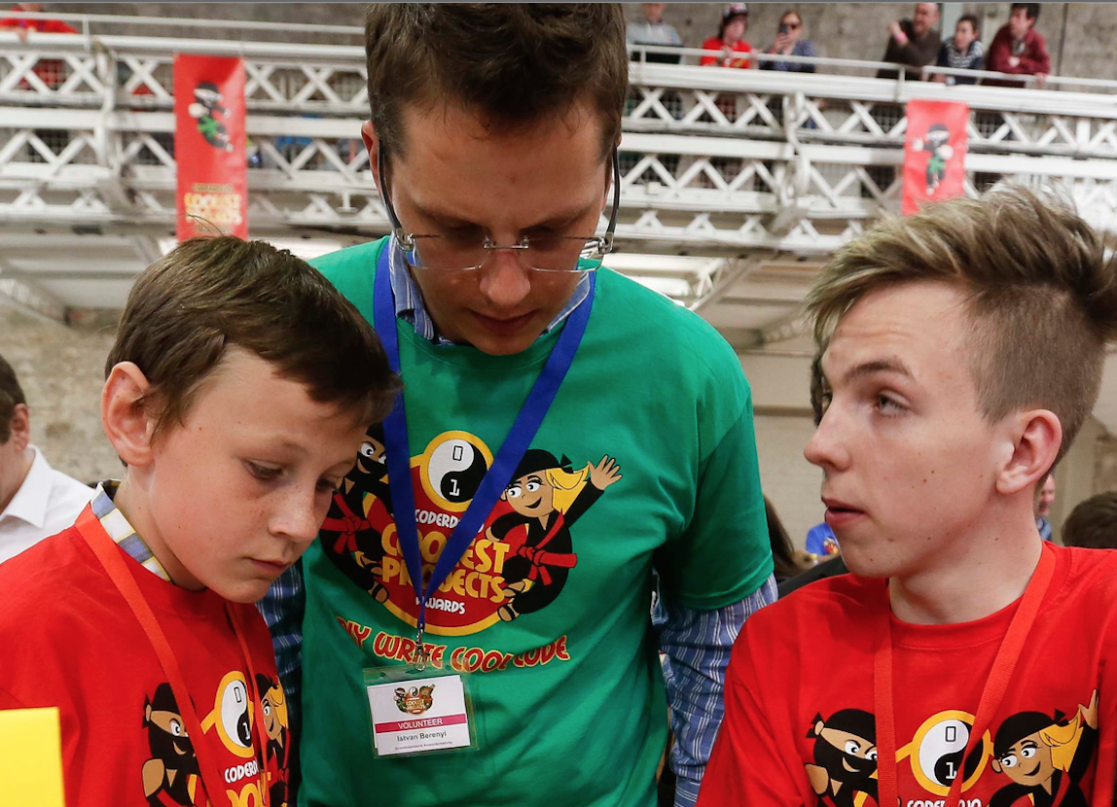
Public Libraries
Designated Space Available
Mentors
Computers
Notes:
A great addition to the library programmes
Getting young people back into libraries

Slide 5
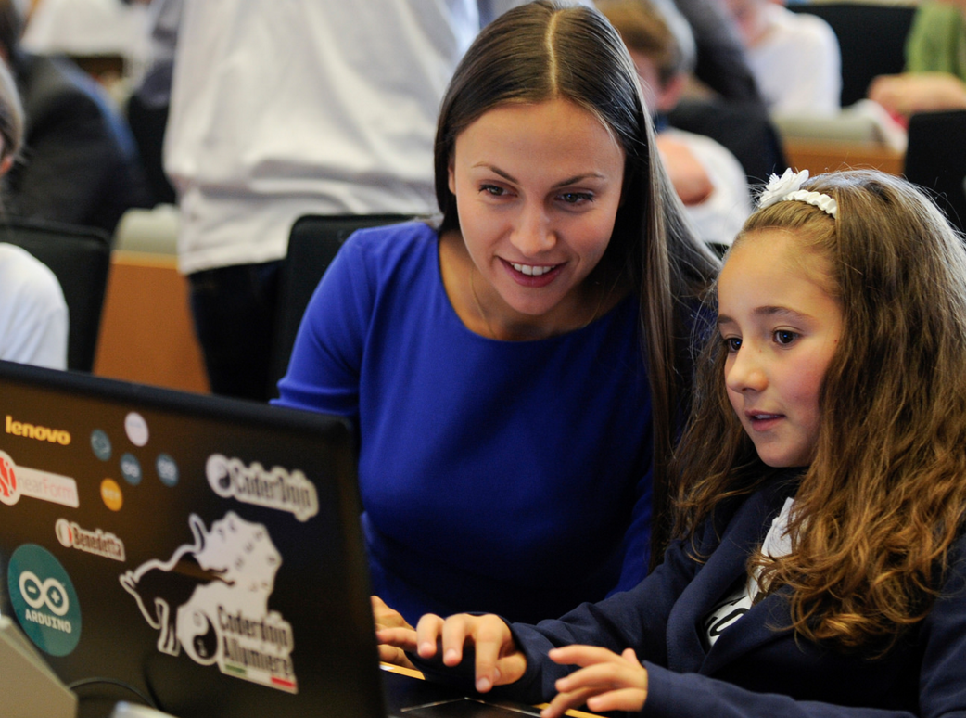
Educational Institutes / Universities
Designated Space
Mentors – Professors and Students
Computers
Notes:
Eg Portugal: There are students running the Dojo and receiving course credits for doing so.

Slide 6
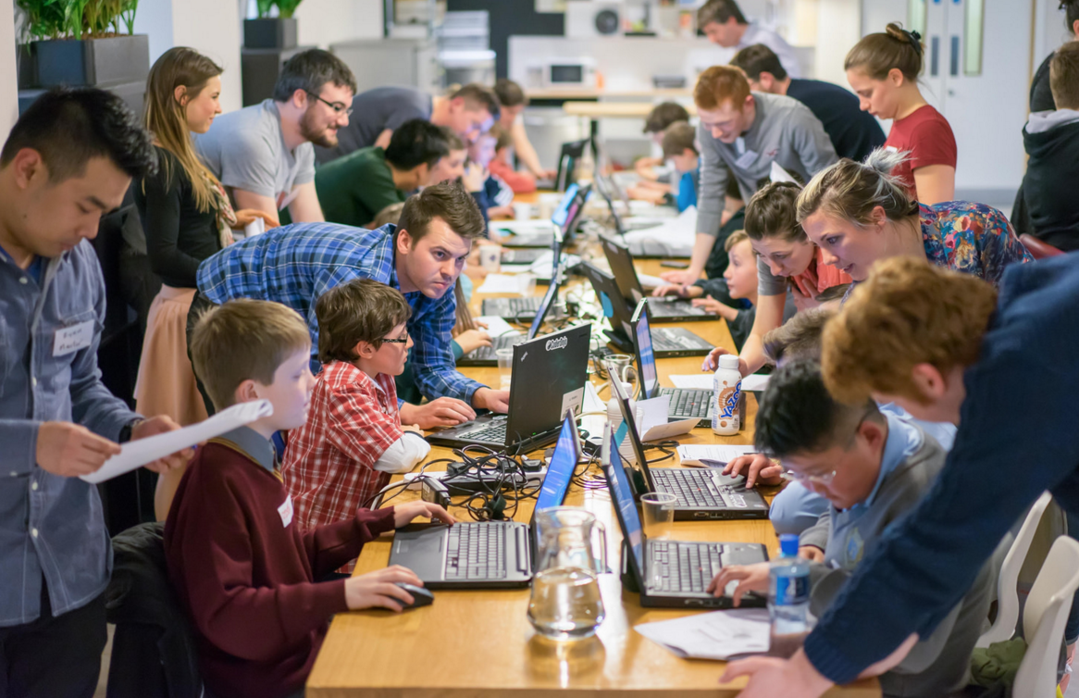
Tech Companies / Startup Hubs
Designated Space
Mentors – Employees
Computers – source funding
Notes:
Docklands Dojo eg

Slide 7
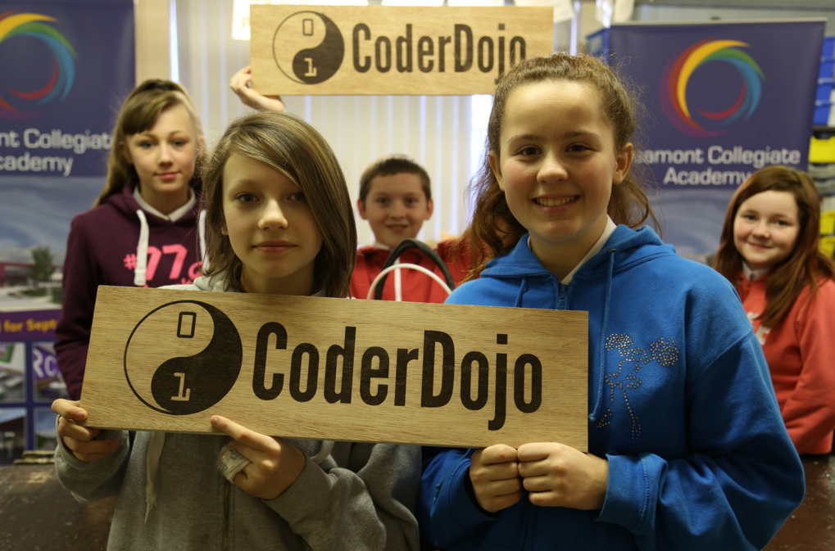
Youth Organisations / Centres
Designated Space
Mentors – Youth workers
Computers – get support
Notes:
Access to under privileged youths

Slide 8
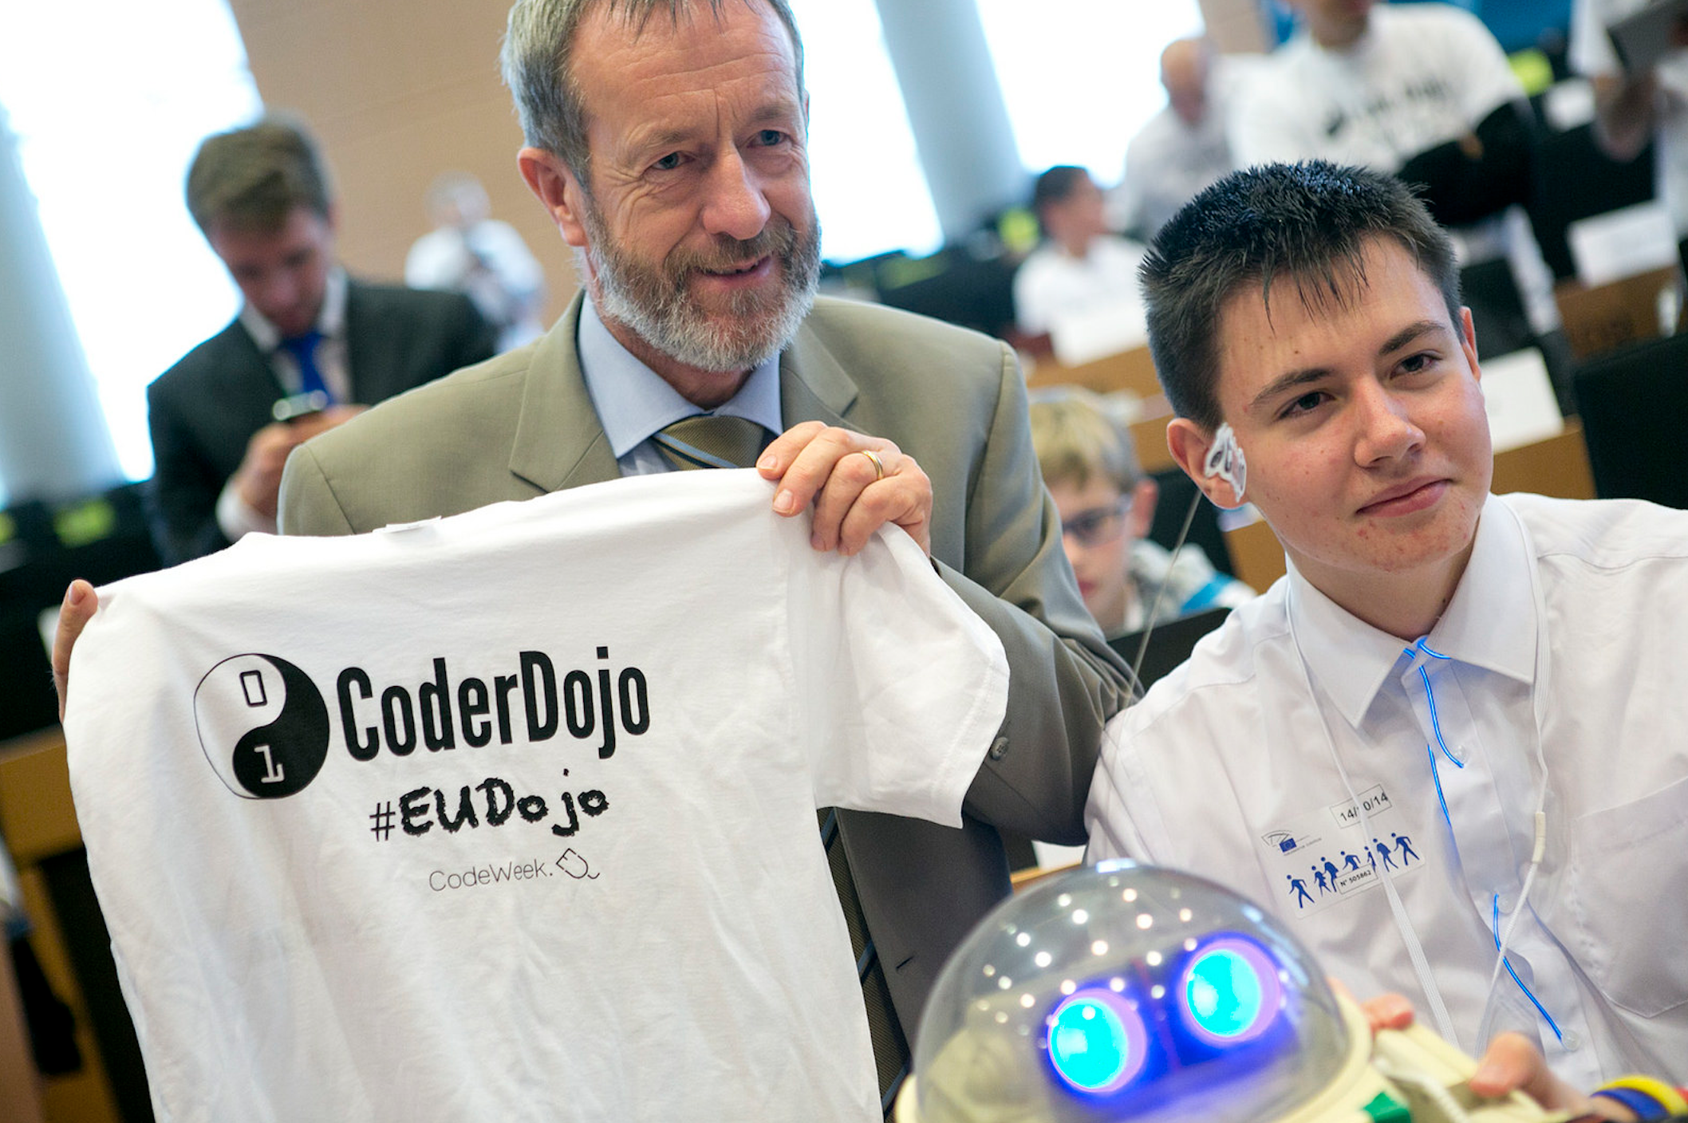
Spreading the word about CoderDojo!
Encourage others to spread the word in your country!
National Politicians
Public figures
Notes:
Q: do you have any ideas that you could enter?

Slide 9
Thank you!
Notes:
Q: do you have any ideas that you could enter?

